Slide 1
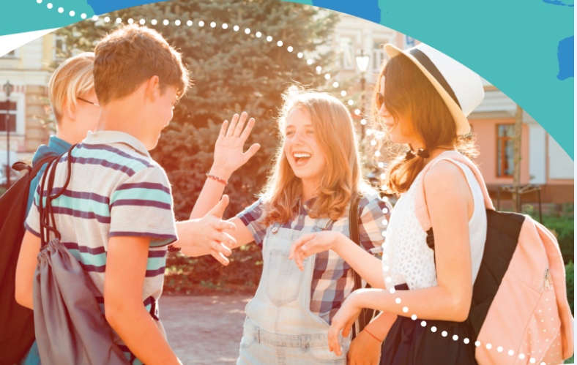


UNIT 4: So much to do, so little time
In my free time

Slide 2
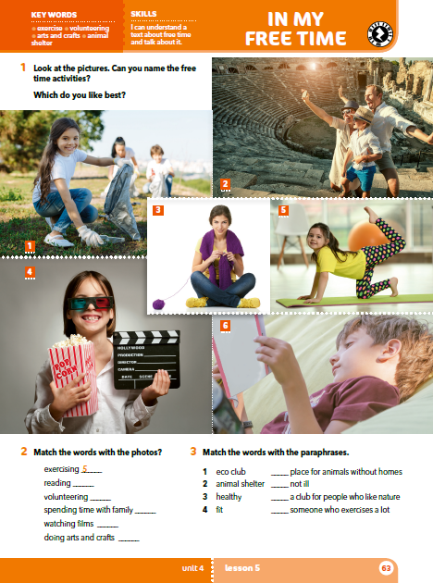
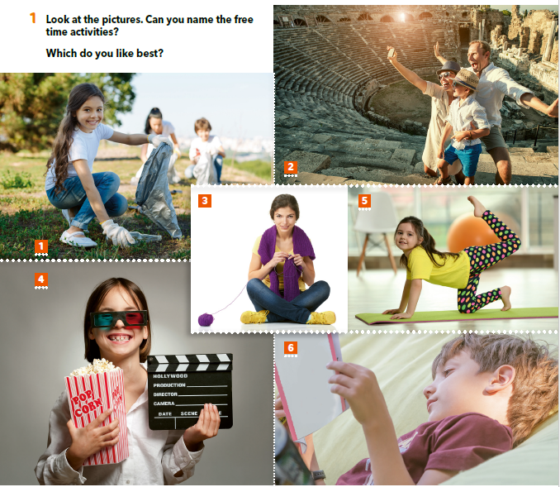
Look at the pictures.
What are they like?
What do they look like?
Can you name the free time activities?
Which do you like the best?

Slide 3
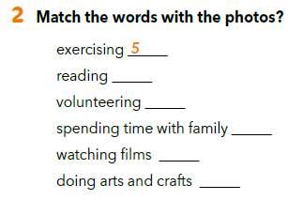
6
1
2
4
3
exercising = vježbanje
arts and crafts = likovno i kreativno izražavanje
PRACTISE:
https://www.bookwidgets.com/play/t:O+pGFYzRpdvuP0sYOvNVXjQHWDNaikeCmezo/vgS/3ZXRUszU1g=

Slide 4
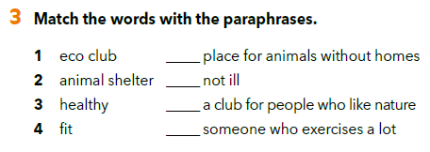
Do you know any eco clubs?
What about animal shelters?
Where are they?
Are you healthy?
Are you fit?
2
3
1
4
animal shelter = sklonište za napuštene životinje
nature = priroda

Slide 5
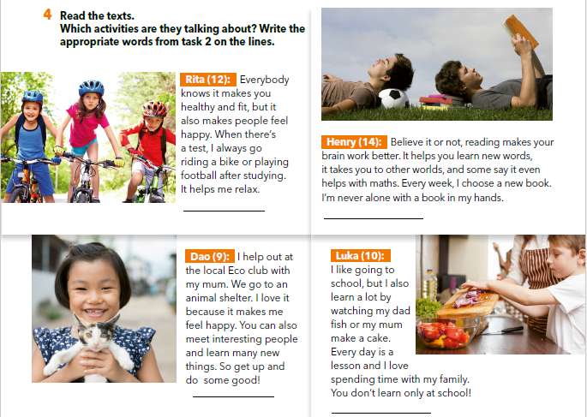
What do you think these people do in their free time?

Slide 6
Scan the texts.
Find words from task 3.
Which activities are they talking about?
Write the word from task 2 on the lines.
exercising
reading
volunteering
spending time with family.

Slide 7
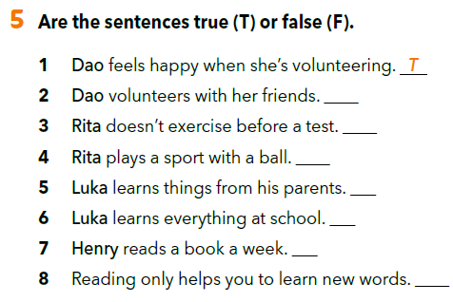
Translate
volunteer =
a book a week =
volontirati
jedna knjiga tjedno

Slide 8
F
F
T
T
F
T
F

Slide 9
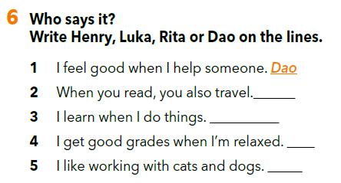
Henry
Luka
Rita
Dao

Slide 10
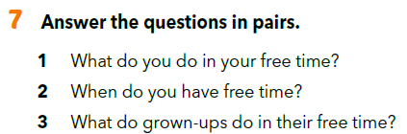

Slide 11
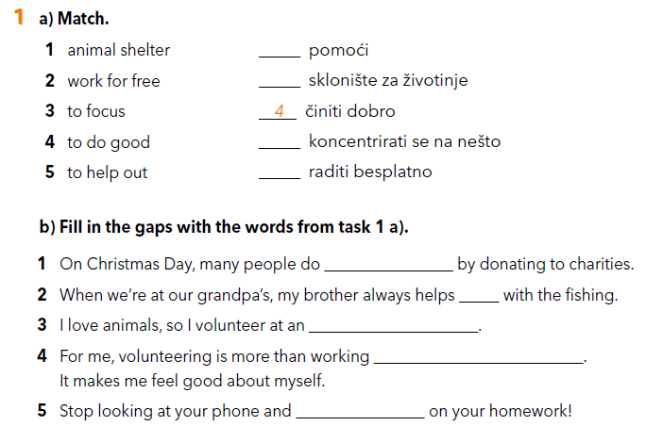
Workbook p 43.
5
1
3
2
good
out
animal shelter
for free
focus

Slide 12
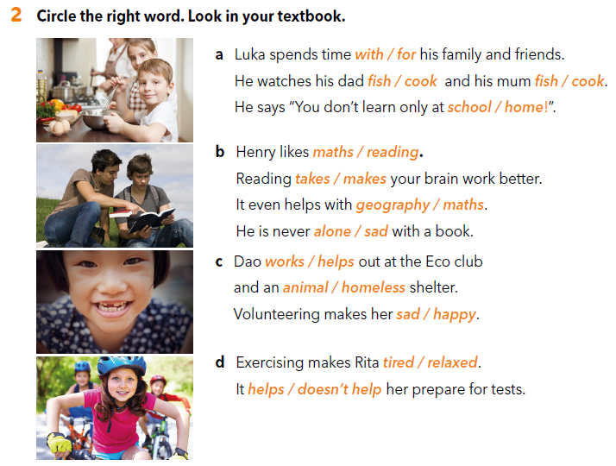

Slide 13

SELF CHECK
https://www.e-sfera.hr/dodatni-digitalni-sadrzaji/91d1ccb5-52b5-4a0d-a5be-a7617b0c0c3f/

